Slide 1
Higher-order thinking skills in language teaching/learning
Penny Ur
2018
25th International IATEFL Slovenia Conference

Slide 2
Higher-order thinking skills
Higher-order thinking skills are those which involve mental effort, which may take various forms (e.g. problem-solving, contrasting, applying, classifying, creating…).
Lower-order thinking skills need little effort, and are mainly associated with recall or identification of ‘surface’ facts or forms.

Slide 3
Various classifications
Bloom’s taxonomy
Convergent versus divergent
Critical thinking
Creative thinking

Slide 4
Critical thinking includes…
Analysis: being able to distinguish between categories, generalize, exemplify etc.
Precision: being aware of imprecision (vague, contradictory or tautologous statements) in input and one’s own self-expression
Logic: being aware of illogical reasoning in input and taking care to be logical in one’s own thinking
Criticism: not taking for granted; being able to to apply criteria in order to evaluate

Slide 5
Creative thinking
The ability to think up original solutions to problems
The ability to create new constructs, interpretations or works of art

Slide 6
Creative thinking includes
Divergent thinking: brainstorming a large number of responses to any cue or task
Original or ‘lateral’ thinking: devising original, unconventional responses to problems or tasks
De Bono, 1967

Slide 7
Reasons for using higher-order thinking in language teaching
Language learning
Intellectual development
Educational values
Interest
Notes:
Language learning: deep processing. If you do something with the language, you are more likely to remember it.
Craik, F. I. M., and Lockhart, R. S. (1972) 'Levels of processing: A framework for memory research', Journal of Verbal Learning and Verbal Behaviour, 11, 6, 671-684.

Slide 8
Language learning
New language items are better imprinted on our memory if we use deep processing.
This means relating the item meaningfully to its meanings and to other items previously learnt.
Deeper processing inevitably involves higher-order thinking skills
Waters, 2006

Slide 9
Intellectual development
The learning of facts and concepts.
+
The ability to relate these to each other, criticize, draw conclusions, create new ideas etc.
Notes:
Importance of facts!

Slide 10
Educational values
The ability and willingness to think for oneself
As distinct from the unthinking acceptance of facts, values, directives etc. laid down by an authority.

Slide 11
Interest
Activities based on simple recall or knowledge of isolated forms and meanings tend to be boring.
Activities based on higher-order thinking skills are likely to be more interesting.

Slide 12
1. Critical thinking

Slide 13
Conventional vocabulary exercises
Match picture to word or definition
Gapfill

Slide 14
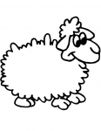





A. A rooster | 1.
B. A sheep | 2.
C. A rabbit | 3.
D. A cat | 4.
E. A dog | 5.
F. A duck | 6.

Slide 15
Analysis (1)
Classifying
a clock, a dog, a dress, a mother, black, a pen, bread, trousers, a bag, a frog, red, boots, a cat, rice, a man, a baby, pink,a teenager, a hat, a t-shirt, a banana, a book, a sheep, meat, kids, a table, green, an elephant, sugar, white
people | clothes | food | things | colours | animals
(vocabulary)

Slide 16
Match
a. unhappy and angry because someone has something you want | 1. angry
b. feeling pleasure or satisfaction | 2. sad
c. lacking interest or energy | 3. jealous
d. having a strong feeling against someone or something that makes you want to shout or hurt them | 4. confident
e. unhappy or sorry | 5. tense
f. nervous, anxious, unable to relax | 6. doubtful
g. uncertain about something | 7. apathetic
h. sure or trusting | 8. happy
Notes:
Do it.

Slide 17
Complete any three
I felt angry because…
I felt sad although…
I felt jealous when …
I felt confident so …
I felt tense although …
I felt doubtful because …
I felt apathetic so …
I felt happy when …
Notes:
Read through, then choose three things you’ve felt recently, and complete the sentences. share in groups

Slide 18
Generalizing
What classes do the following belong to?
a hammer – a tool
sadness –
a table -
a mother -
a palace -
December -
winter -
biology -
tennis –
(vocabulary)

Slide 19
Conventional grammar exercises
Gapfill
Sentence-completion items

Slide 20
Relative pronouns
(conventional exercise)
Q1 - Stratford is the town ____ Shakespeare was born in.
a. where b. which c. Either could be used here.
Q2 - The hotel ____ we stayed was good.
a. where b. which c. Either could be used here.
Q3 - The man ____ interviewed me seemed friendly enough.
a. who b. which c. Either could be used here.
Q4 - The British Prime Minister, ____ was interviewed yesterday, denied responsibility.
a. who b. that c. Either could be used here.
Q5 - The car ____ was stolen belonged to my partner.
a. which b. that c. Either could be used here.

Slide 21
Analysis (2)
Logical analysis and exemplification
Define the following items:
Example: A hammer is a tool which…
a cow
Canada
a chicken
a carpenter
cigarettes
coffee
a cinema
Christmas
(relative pronouns and clauses)

Slide 22
List 1 Australia apples August an airport an artist an African an alligator air | List 2 a book Bangladesh bread a bedroom a baby bottles a bus a birthday | List 3 a cow Canada a chicken a carpenter cigarettes coffee a cinema Christmas
List 4 a duck a doctor Denmark doors December a dream a daughter disinfectant | List 5 eyes England an elephant the evening an emperor an engine economics eight | List 6 Hollywood a helicopter hands a hotel happiness a hairdresser history a horse
Ur, Grammar practice activities, 2009

Slide 23
Analysis (3)
Generalizing
Here is a list of sentences.
We have been working here for a long time.
They have been in the country since 1995.
The program has been going on for ten minutes.
I have loved this singer since the beginning of her career.
We have been studying English for four years.
She has lived in Haifa since she got married.
When do you use since and when do you use for?
(grammar)

Slide 24
Precision (1)
Inherent contradiction
Do these make sense?
an objective opinion
a definite maybe
an exact estimate
the larger half
(vocabulary, critical reading)

Slide 25
Precision (2)
Tautology
What’s wrong with these?
A free gift
A new innovation.
We made too many wrong mistakes
He exaggerated the situation too much.
It’s pure undiluted orange juice.
Let’s meet together at six.
They commute back and forth every day.
(vocabulary, critical reading)

Slide 26
Logic (1)
Underlying assumptions
What (unsubstantiated) assumptions underlie these statements?
This food is composed entirely of natural ingredients, so it is good for you as well as being delicious.
This method is scientifically proven to be effective
Thousands of people have already signed up: join now!
Don’t use this method: it is based on outdated, old-fashioned ideas.
Everyone knows that the earlier you start learning a language the more successfully you will master it.
(critical reading, writing)

Slide 27
Logic (2)
Reasoning: Premise and conclusion
What’s wrong with these?
These people drink a lot of red wine and have few heart problems: so drinking red wine is good for your heart.
The boy told me he’d left his book at home, but it was in fact in his bag: so he was lying. That shows he is a liar.
The word ‘education’ comes from a Latin word meaning ‘to draw out’, so education is about drawing out people’s potential.
She spends a lot of time reading, so she reads very well.
(critical reading, writing)

Slide 28
Logic (3)
Ambiguity
What’s wrong with these sentences?
We need more comprehensive schools.
Visiting relatives can be boring.
Ambulance man helps dog bite victim
Enraged cow injures farmer with ax
Juvenile court to try shooting defendant
Stolen painting found by tree
Two sisters reunited after 18 years in checkout counter
Kids make nutritious snacks
(linguistic awareness, contrastive analysis)

Slide 29
Logic (4)
Evidence-based conclusions
What would be your conclusion from this evidence?
  She’s wearing a white coat.
  She’s wearing a stethoscope round her neck.
  I saw her examining a patient.
  In her office there’s a certificate that says she graduated from medical school.
  She was interviewed on television about a disease.
  There’s a notice outside her door that says ‘Dr Smith’.
“She must be a doctor.”
(grammar: must/ can’t of logical necessity)

Slide 30
Logic (4)
Evidence-based conclusions
    He never smiles.
    We sometimes see him cry.
    The funniest jokes can’t make him laugh.
    He stays at home all the time.
  “He can’t be very happy.”
  “He must be unhappy”
  “He must be depressed”
  (grammar: must/ can’t of logical necessity)

Slide 31
Logic (5)
Coherence
Insert an appropriate conjunction: because / since, although/in spite of the fact that, so/therefore, but/however/nevertheless, and, moreover/in addition, if / provided that
She is a good teacher … she hasn’t had much training.
I know they are here… I saw them a moment ago.
She has ten children … she still has time to write books.
He is a good boss … he has a sense of humour.
We will come … we get an invitation.
We will certainly come … we have plenty of time.
He’s lived in the US all his life… he must know English.
He is a good speaker … I don’t like him very much.
There isn’t much water in the desert … not many plants can grow there.
It seems there’s plenty of time … we need to get started immediately.
(conjunctions)

Slide 32
2. Creative thinking

Slide 33
1. Divergent thinking
How many things can you think of to say about this picture?
(oral fluency)
How many ways can you think of to solve this dilemma?
(oral fluency)
How many ways can you think of to compare a train with a car?
(comparatives)
How many endings can you think of for the sentence: If I had a million dollars…?
(conditionals)

Slide 34
How many ways can you think of to use an empty tin can? (A pen? A piece of plasticine?)
(oral fluency, can/could)
How many adjectives can you think of to describe the noun road? movie? song?
(grammar: adjective-before-noun, vocabulary)
How many nouns can you think of that could be described by the adjective clear? (hard? black?)
(adjective-before-noun, vocabulary)

Slide 35
2. Originality, ‘lateral’ thinking
Think of ten ways to compare a computer with a piece of spaghetti.
Find six questions to which the answer is …twelve…(tomorrow …of course! …my mother …)
Suggest at least three advantages of being an only child? (Of not having a cellphone? Of having no car?)

Slide 36
Name ten things you have never done.
Name six things that you can’t touch, and why.
Say six negative things about …a pen … a cat … English.
Say four NICE things about your friend, using negative sentences.

Slide 37
Coping with Internet information

Slide 38

Critical thinking
Today critical thinking skills need to be employed in the course of exposure to Internet information
.
Most of it in English.
Notes:
always a need for creative. But today – need for critical thinking

Slide 39
‘Information’ includes
(true) facts
partial facts
facts + non-facts
opinions disguised as facts
misinformation

Slide 40
New vocabulary
fake news
truthiness
post-truth
advertorials

Slide 41
Just because it’s written up there doesn’t necessarily mean it’s true.
How do I know?

Slide 42
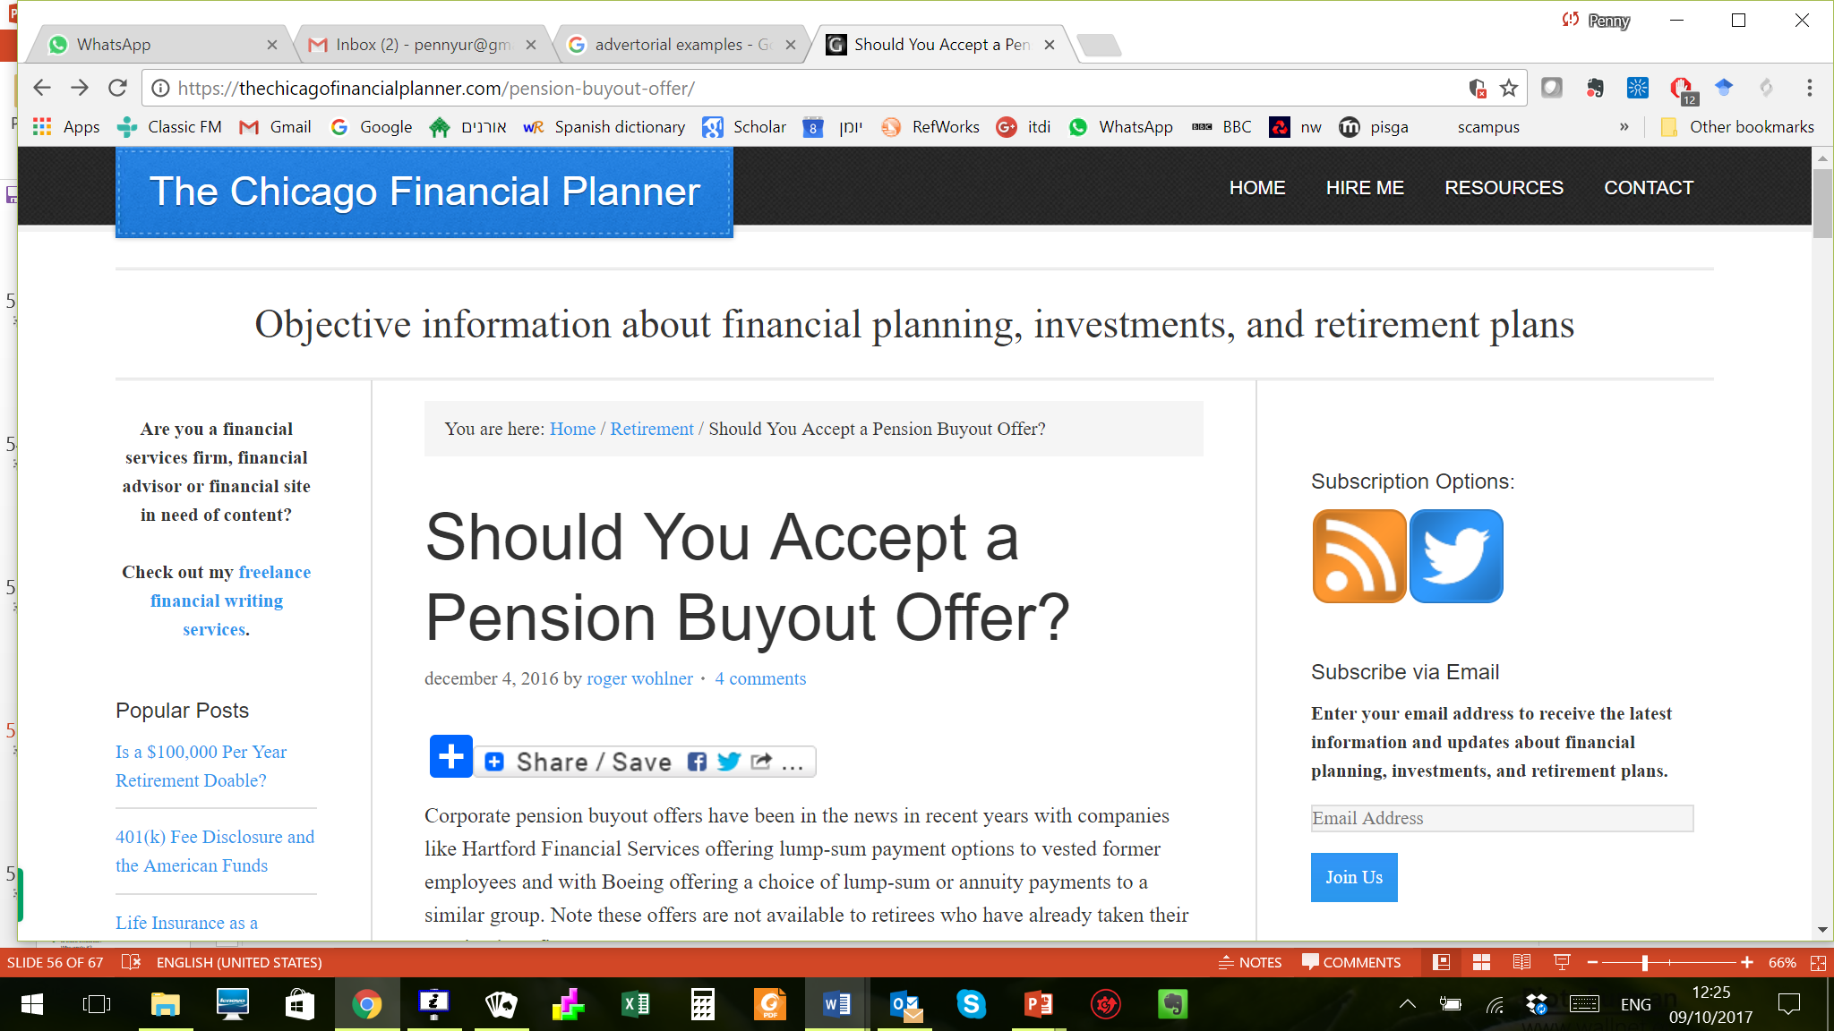

Slide 43
Fake news
NASA WARNS 'PLANET X' IS HEADED STRAIGHT FOR EARTH
PERMANENT CLOSURE AT WALT DISNEY WORLD DUE TO HURRICANE IRMA

Slide 44


Slide 45
Get suspicious if...
The content is unlikely and sensational
It arouses a strong positive or negative reaction (you want it/don’t want it to be true)
It’s trying to persuade you to spend money
You saw it on a website you haven’t met before
It reached you through social media or email
The headline is big, capitalized, maybe with exclamation marks
It has no date or acknowledged author.
It provides no evidence or sources of information

Slide 46
So evaluate:
  (News item) Is it likely?
  Is it an advertisement?
  Is the argument logical?
  Is there evidence?
  Who wrote it?
  Is the journal / newspaper / website likely to be objective? Or does it have commercial or political interests?

Slide 47
An example
In the light of the OECD report, I was interested to know whether students use/prefer digital textbooks.
There’s plenty of research providing conflicting evidence: yes and no.

Slide 48
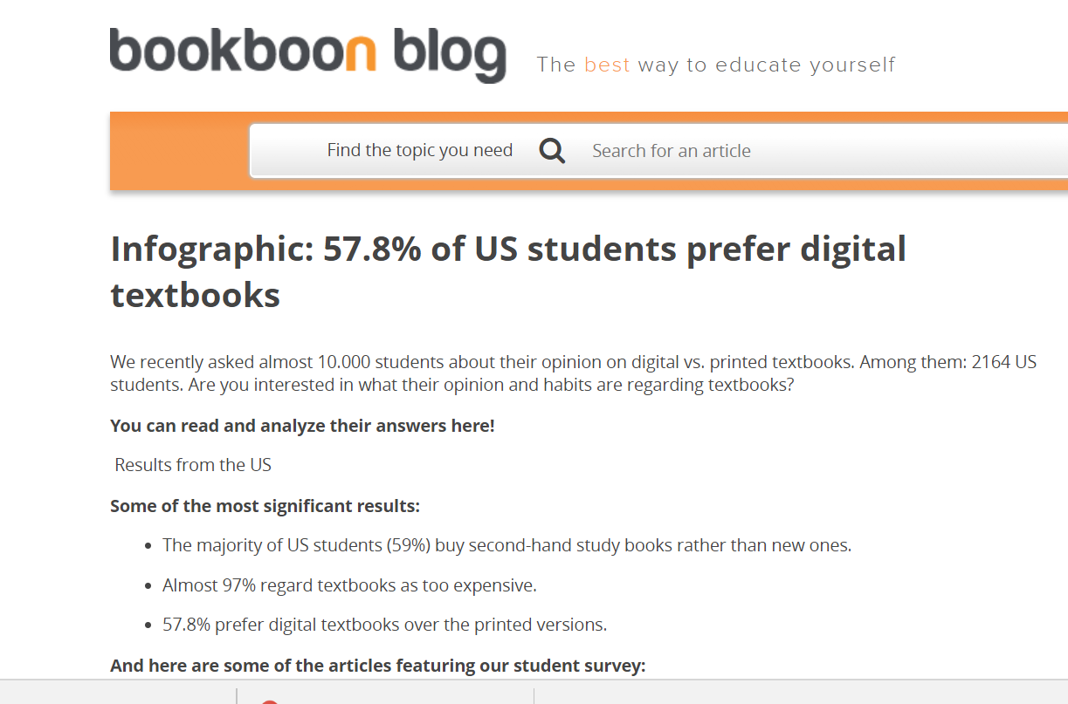

Slide 49
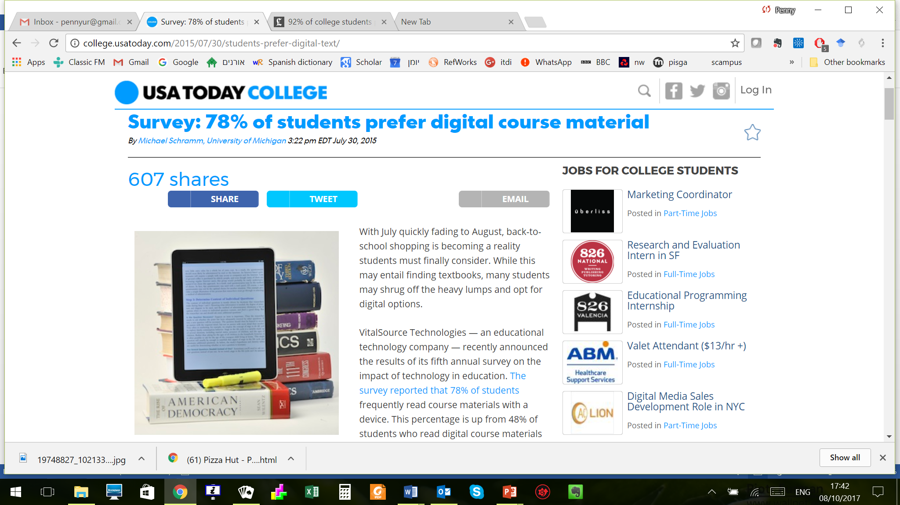

Slide 50
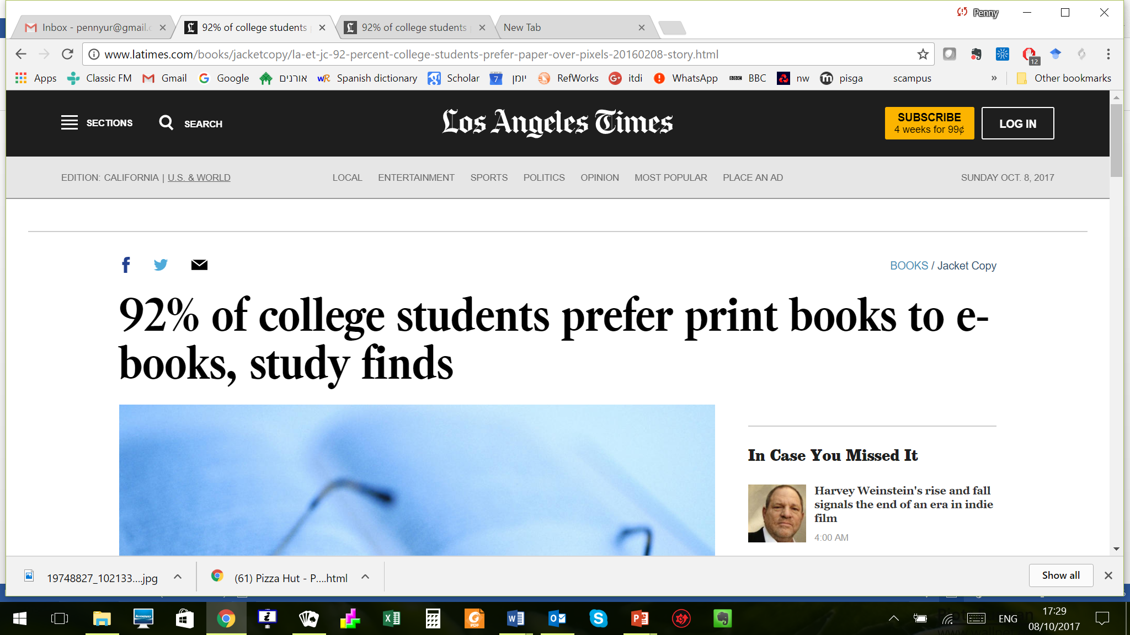

Slide 51
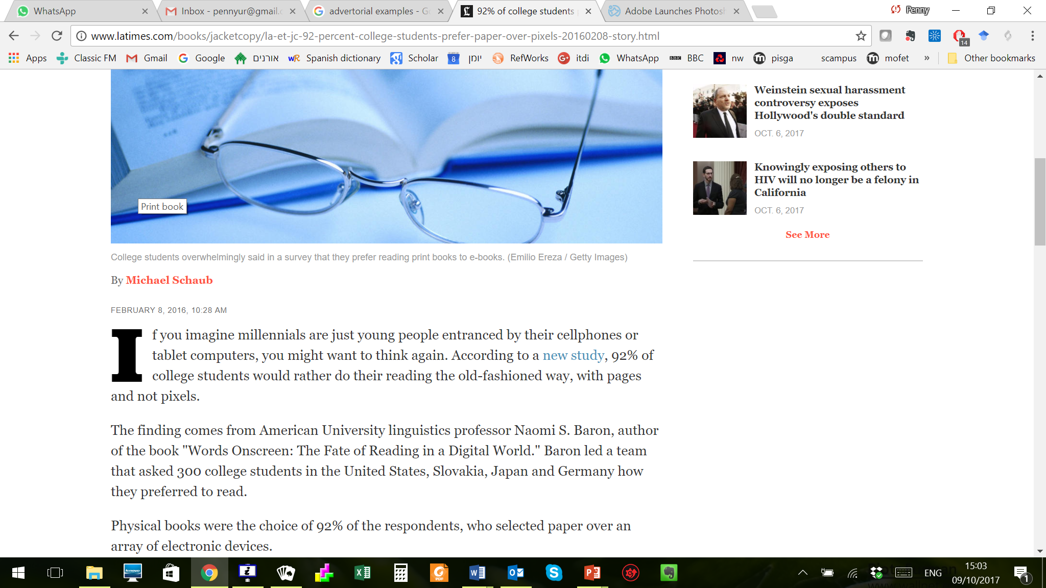

Slide 52
I checked out
Likelihood?
Website?
Source or author?
Evidence?

Slide 53
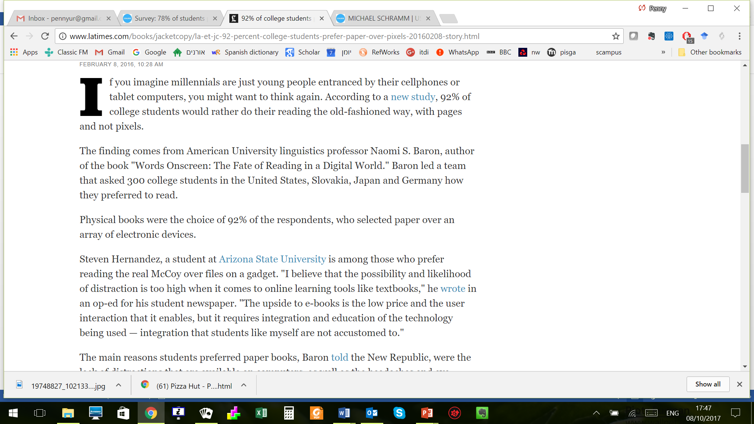

Slide 54
Baron, N. S., Calixte, R. M., & Havewala, M. (2017). The persistence of print among university students: An exploratory study. Telematics and Informatics, 34(5), 590-604.

Slide 55
Some concluding comments 1
There is no strict dividing line between lower- and higher-order thinking skills.
It’s a continuum.

Slide 56
Some concluding comments 2
The use of higher order thinking skills in language teaching materials contribute to good learning, and are important..
However:
Knowledge of facts and lower-order thinking skills are basic and essential.
Notes:
So I’m not advocating the use of only HOTS! And any HOTS activity will also involve LOTS.

Slide 57
Some concluding comments 3
It is easier to implement higher-order thinking skills in more advanced materials in the upper grades.
However:
It is just as important, and perfectly feasible, to implement them in beginner and intermediate materials, or in courses for elementary and middle school.

Slide 58
Critical thinking is crucial when approaching material accessed through Internet sources.
Students should be encouraged to be on the lookout for distortions, illogical argument, gaps, contradictions and lack of evidence...
... and aware that ‘news’ features may sometimes be fake news or advertorials

Slide 59
References
Bloom B. S. (ed). (1956). A Taxonomy of Educational Objectives. New York: Longman.
  De Bono, E. (1967). The use of lateral thinking. Harmondsworth: Penguin.
Waters, A. (2006). Thinking and language learning . ELT Journal, 60(4), 319-327.
Ur, P. (2009). Grammar practice activities. Cambridge: Cambridge University Press

Slide 60
Thank you for your attention!
pennyur@gmail.com

